Slide 1

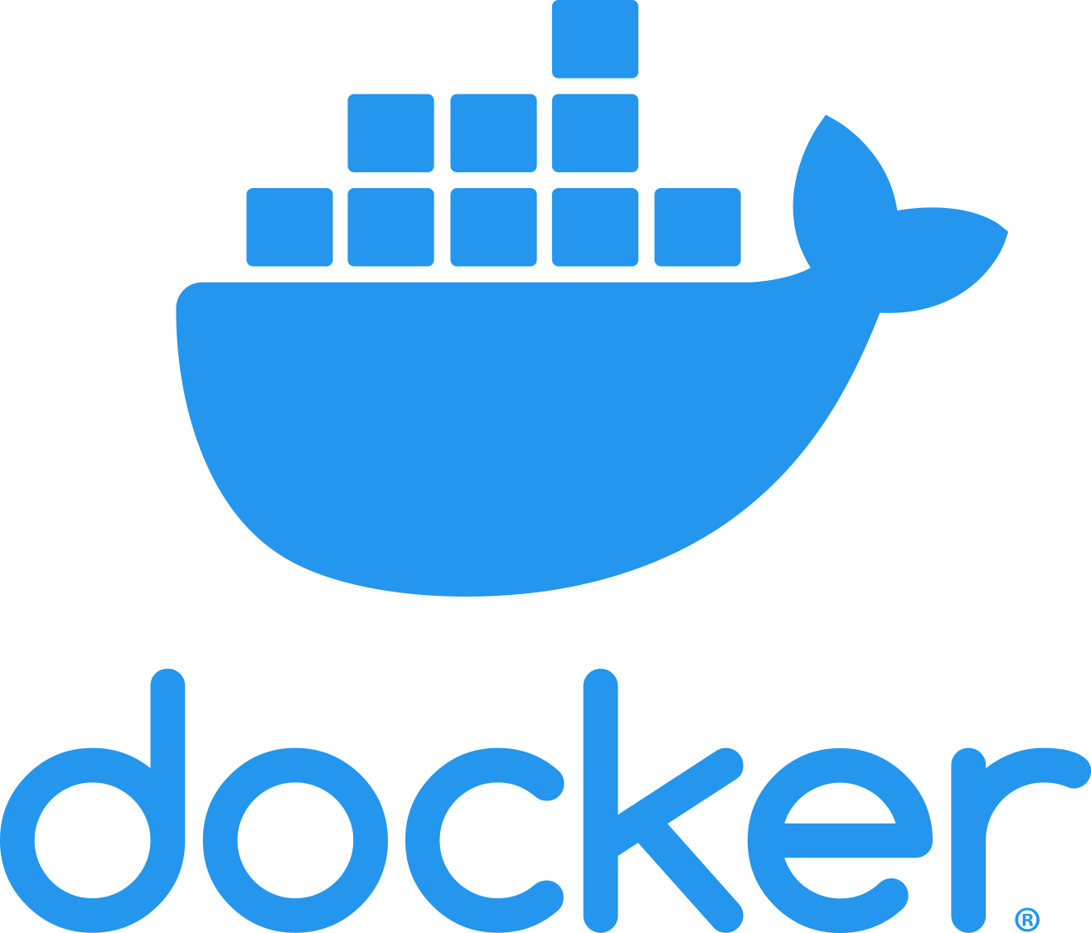
Apresentação Individual
Rodrigo Leal, nº44823

Slide 2
Index
What is Docker?
Container VS Virtual Machine
Under The Hood
Docker Image
Dockerfile
Dockerfile Example

Slide 3
What is Docker?
Tool
Easier to create, deploy, and run applications by using containers
Docker Container
Standardized unit of software
Virtualized run-time environment
Allow developers to isolate their app from its environment
Lightweight
Secure

Slide 4
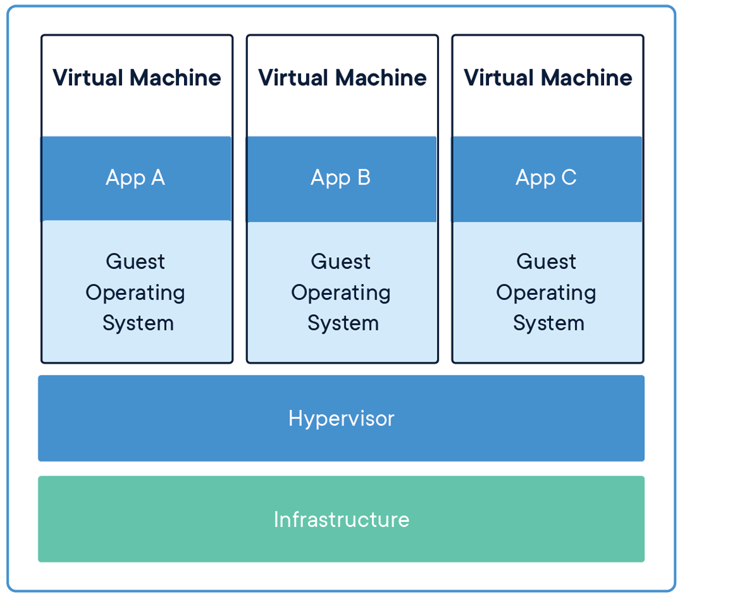
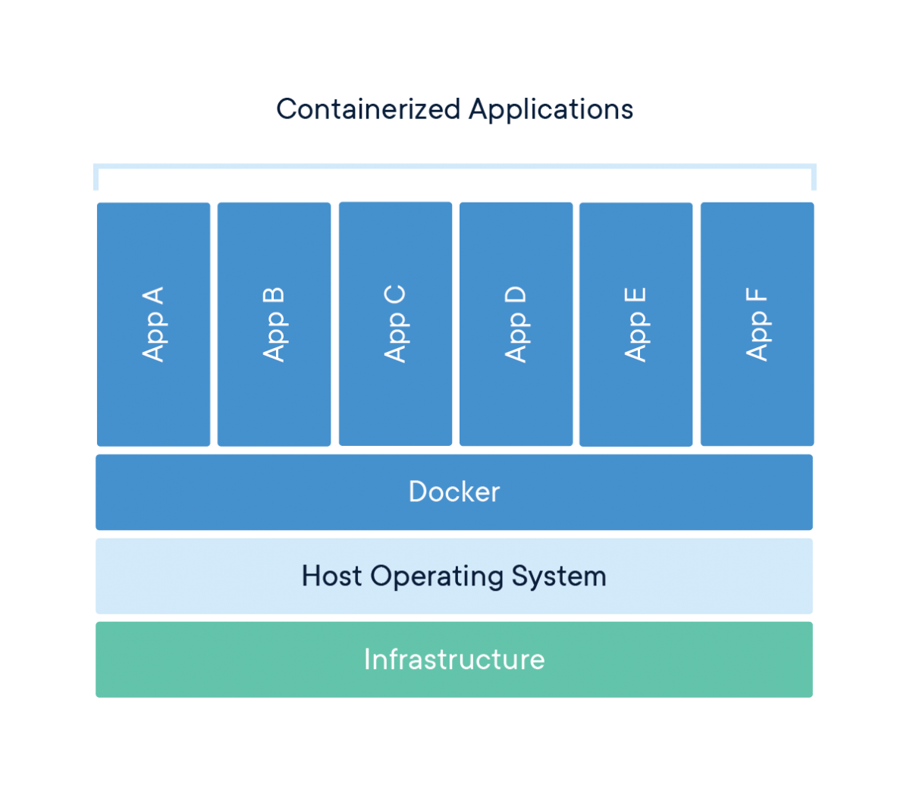
Container VS Virtual Machine
Similar resource isolation and allocation benefits
Containers share system kernel

Slide 5
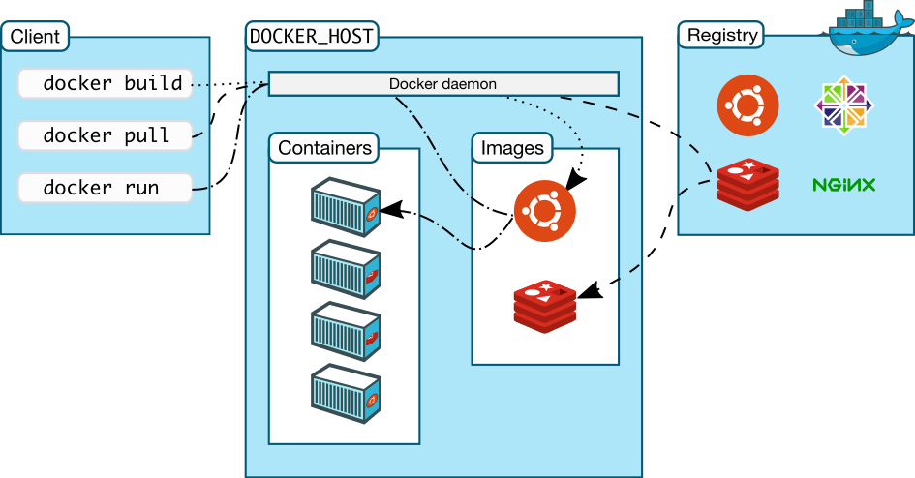
Under the Hood
Docker Engine
Container runtime
Client-server architecture
CLI
API
Daemon
Manages containers
Handles docker objects
Containers
Images
Services
Networks
Volumes

Slide 6
Docker Image
Docker Image
Immutable (read-only)
Everything needed to run an application
Images become containers
Docker registry
Contains Docker images
Public
Docker Hub
Private
Docker
Artifactory
Amazon Elastic Container Registry

Slide 7
Dockerfile
Text file which includes instructions to build a Docker image
FROM
ARG
docker build --build-arg user=what_user .
RUN
ENV
ADD
COPY
CMD
ENTRYPOINT
EXPOSE
USER

Slide 8
DockerFile Example
FROM openjdk:13
RUN yum -y update \
&& yum -y install wget
RUN wget https://github.com/JetBrains/kotlin/releases/download/v1.3.71/kotlin-compiler-1.3.71.zip -O temp.zip
RUN yum -y install unzip
RUN unzip temp.zip
RUN rm temp.zip
ENV PATH="/kotlinc/bin:${PATH}"
COPY KotlinExecutionEnvironment-1.0.0-SNAPSHOT-spring-boot.jar .
COPY ./libs ./libs
ENTRYPOINT java -jar KotlinExecutionEnvironment-1.0.0-SNAPSHOT-spring-boot.jar
EXPOSE 8080

Slide 9
Thank you

Slide 10
References
https://opensource.com/resources/what-docker
https://www.docker.com/
https://docs.docker.com/
https://phoenixnap.com/kb/docker-image-vs-container
https://docs.docker.com/glossary/

